Slide 1

The Machine Learning Process
How do I find and remove duplicate rows in pandas?
Reza Dibaj

Slide 2
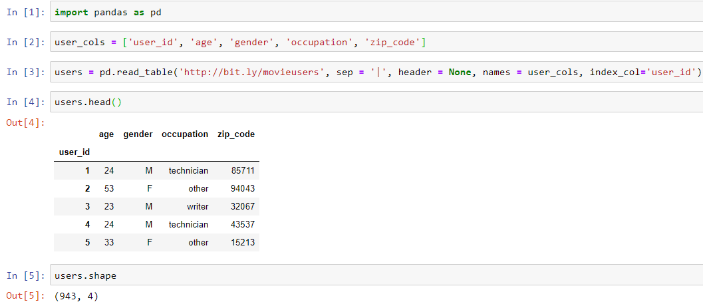
Finding and removing duplicate rows
Let’s pull up a dataset for today….
Notes:
import pandas as pd
user_cols = ['user_id', 'age', 'gender', 'occupation', 'zip_code’]
users = pd.read_table('http://bit.ly/movieusers', sep = '|', header = None, names = user_cols, index_col='user_id’)
users.head()
users.shape

Slide 3
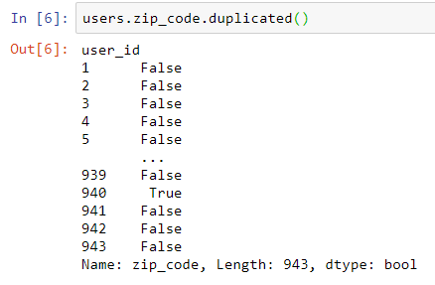
Finding and removing duplicate rows
We want to find duplicate zip codes….
For this we use a Series method as follows:
The logic is, wherever we see a True value, it shows there is a duplicated value above it.
Notes:
users.zip_code.duplicated()

Slide 4

Finding and removing duplicate rows
To calculate the total number of duplicates we run the following command:
Notes:
users.zip_code.duplicated().sum()

Slide 5
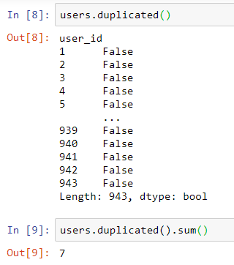
Finding and removing duplicate rows
We can see the duplicated in the DF level as follows:
It returns True if the entire row is identical to its previous row.
Notes:
users.duplicated()
users.duplicated().sum()

Slide 6
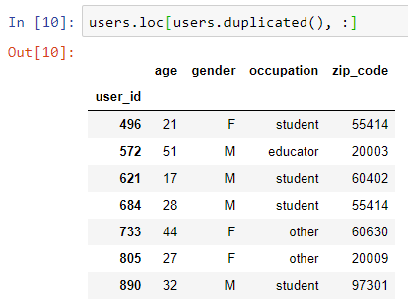
Finding and removing duplicate rows
The following is the way that we can show the duplicated row:
Spend a few second to discover how it actually works.
Notes:
users.loc[users.duplicated(), :]

Slide 7
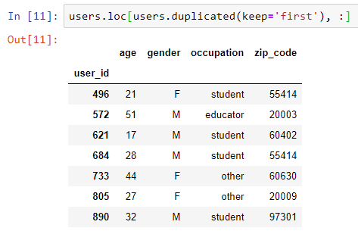
Finding and removing duplicate rows
What do you think the following command do? What is different from the previous slide? What is the role of added parameter?
Notes:
users.loc[users.duplicated(keep='first'), :]
#It marks the duplicate as True except the first occurrence.

Slide 8
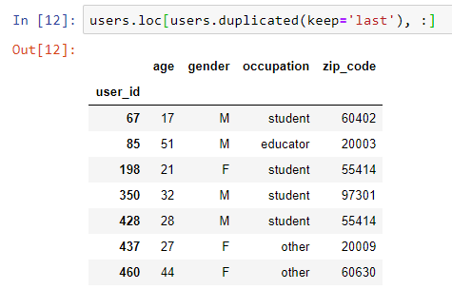
Finding and removing duplicate rows
And now you can change the logic and keep the last:
Notes:
users.loc[users.duplicated(keep='last'), :]

Slide 9
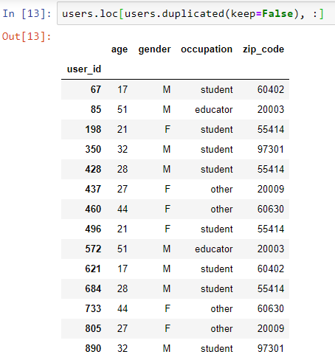
Finding and removing duplicate rows
The following option marks all duplicate rows as True.
Notes:
users.loc[users.duplicated(keep=False), :]

Slide 10
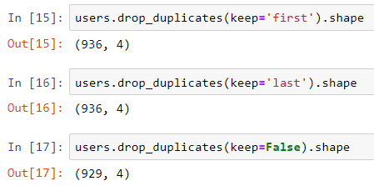
Finding and removing duplicate rows
What if we want to drop the duplicates from the DF:
As you may guess, the inplace value is equal to False, by default.
Default
Notes:
users.drop_duplicates(keep='first').shape
users.drop_duplicates(keep='last').shape
users.drop_duplicates(keep=False).shape

Slide 11
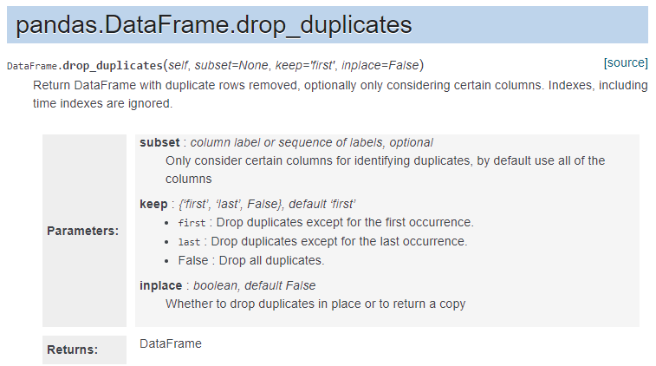
Finding and removing duplicate rows
Here is the relevant document:
Notes:
https://pandas.pydata.org/pandas-docs/stable/reference/api/pandas.DataFrame.drop_duplicates.html

Slide 12



Bonus Tip
What if we only want to consider certain columns, when identifying duplicates?
Imagine that “age” + “zip_code” should be a unique identifier in our dataset. (there is no logic behind it and it is for the sake of example)
Similarly, we can drop the duplicate rows for the above scenario as follows:
Notes:
users.duplicated(subset=['age','zip_code']).sum()
users.drop_duplicates(subset=['age','zip_code']).shape

Slide 13

Thank you
Question?
To be
Not to be

